Slide 1


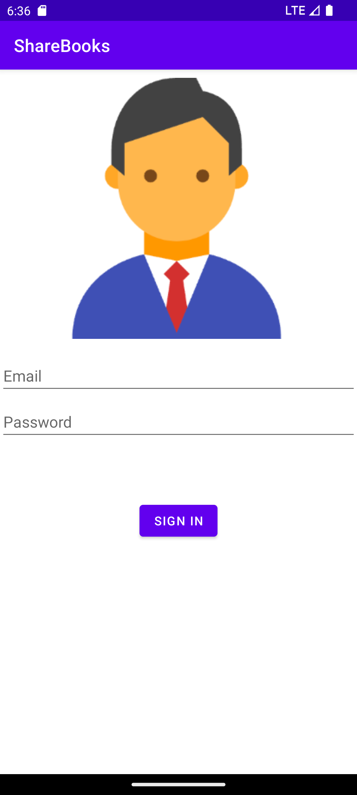

GROUP G35 (Group 35)
Group members |
Anbo Wu (u7706346)
Huizhe Ruan (u7723366)
Chuang Ma (u7703247)
Junfeng Gao (u7615533)
Diao Fu (u7722376)
*presenter(s)

Slide 2


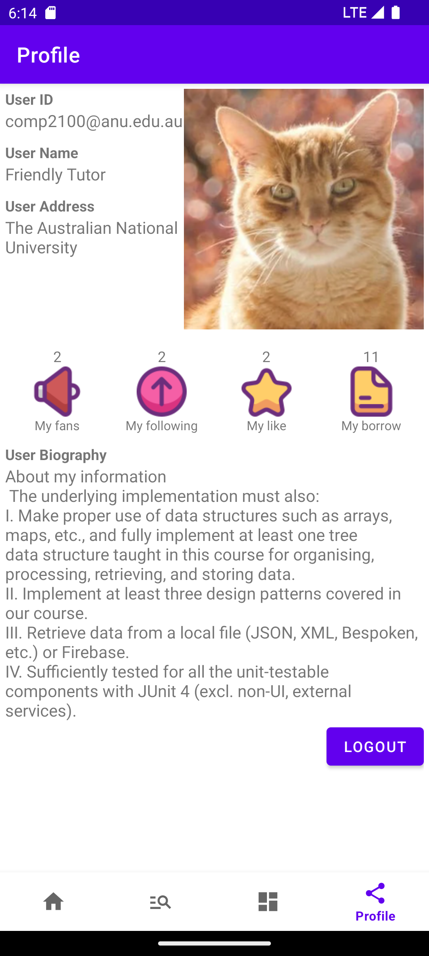
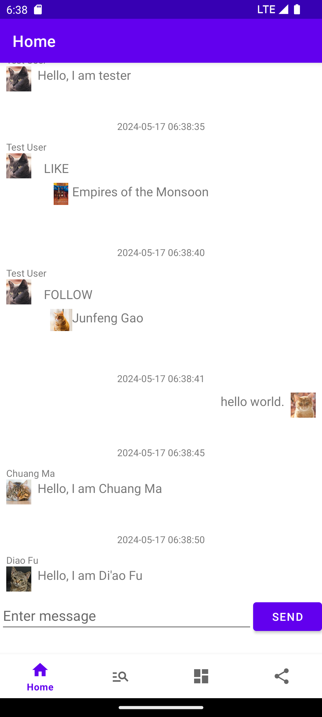
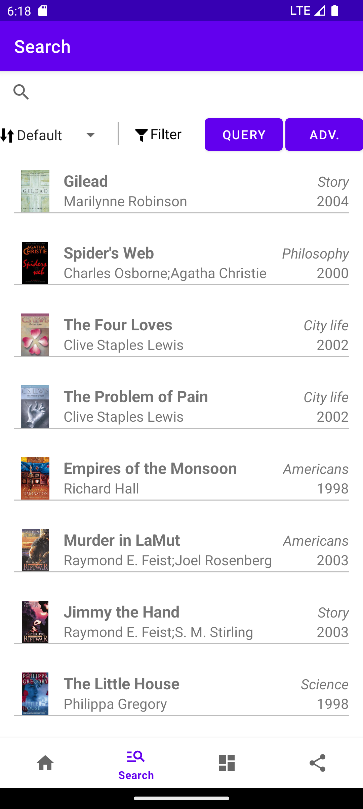
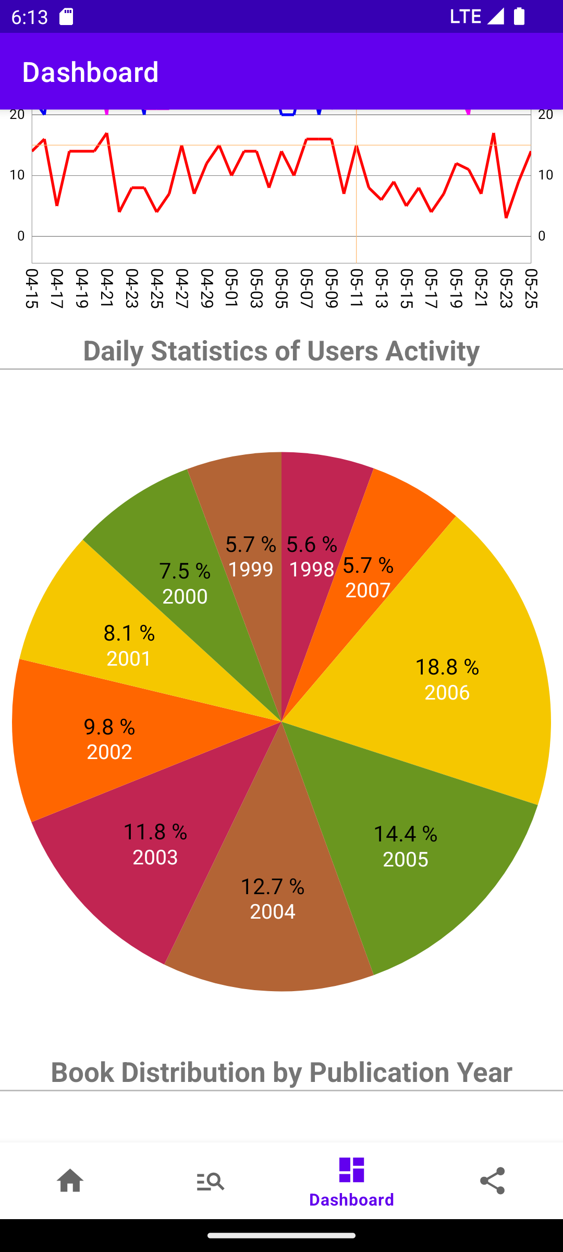
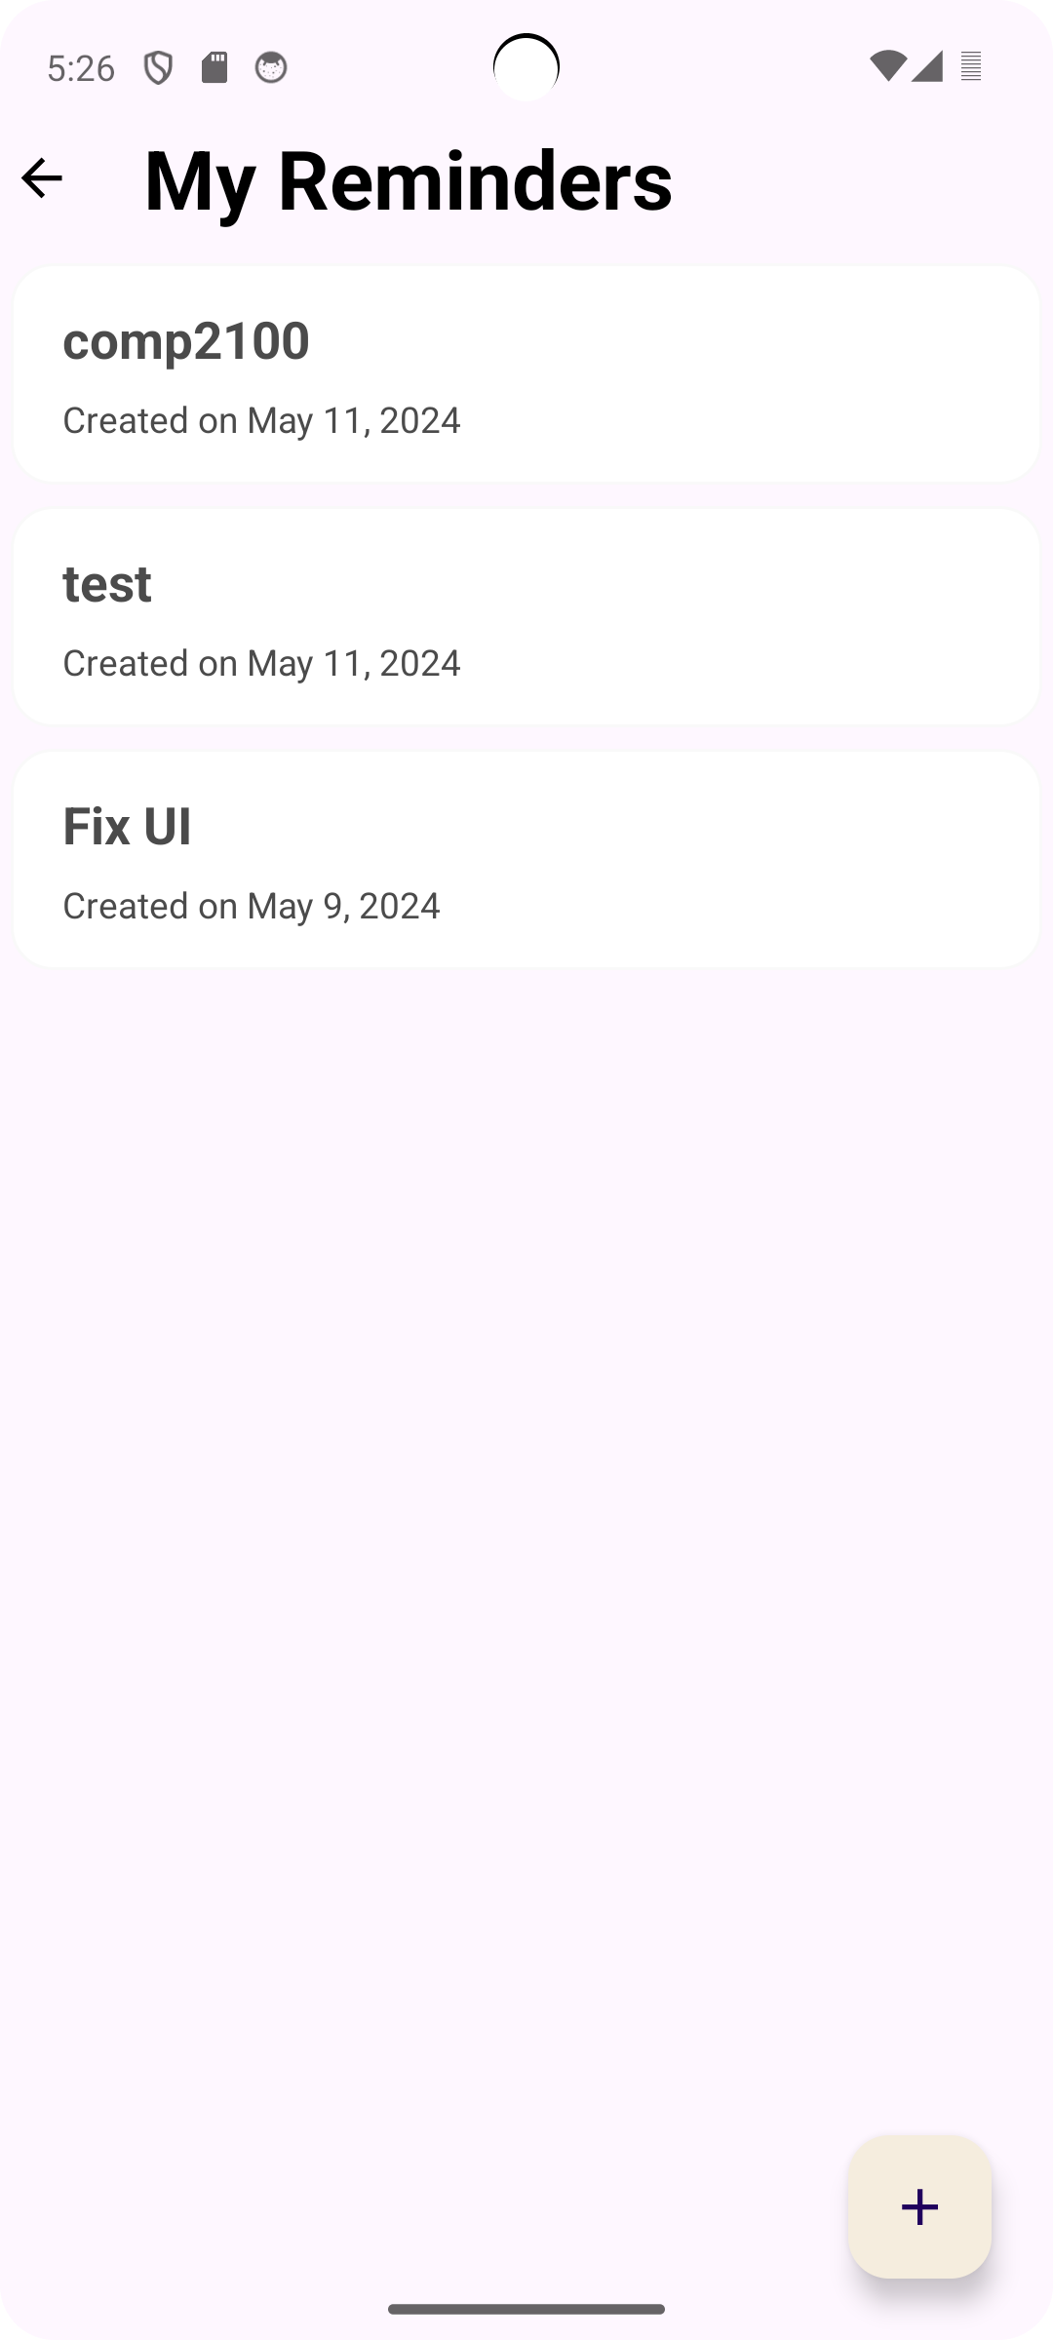
Overview
ANU Share Book
… and more
1/3

Slide 3



Search
Search Mode:
Normal Mode: Search for results(name,year) in books
Custom Grammar Mode: Auto Invoke, Search by instruction
Grammar:
<exp> ::= <term> | <term> & <exp> | <term> | <exp>
<term> ::= <key> | ( <exp> )
<key> ::= ISBN | TITLE | AUTHORS | CATEGORY | YEAR
Example:
(CATEGORY:City life|CATEGORY:Graphic Novels)&(YEAR:2001|YEAR:2005)
Handling Invalid:
Parser detect -> UI prompt info
Filter:
By Year, Title and Auth
2/3

Slide 4
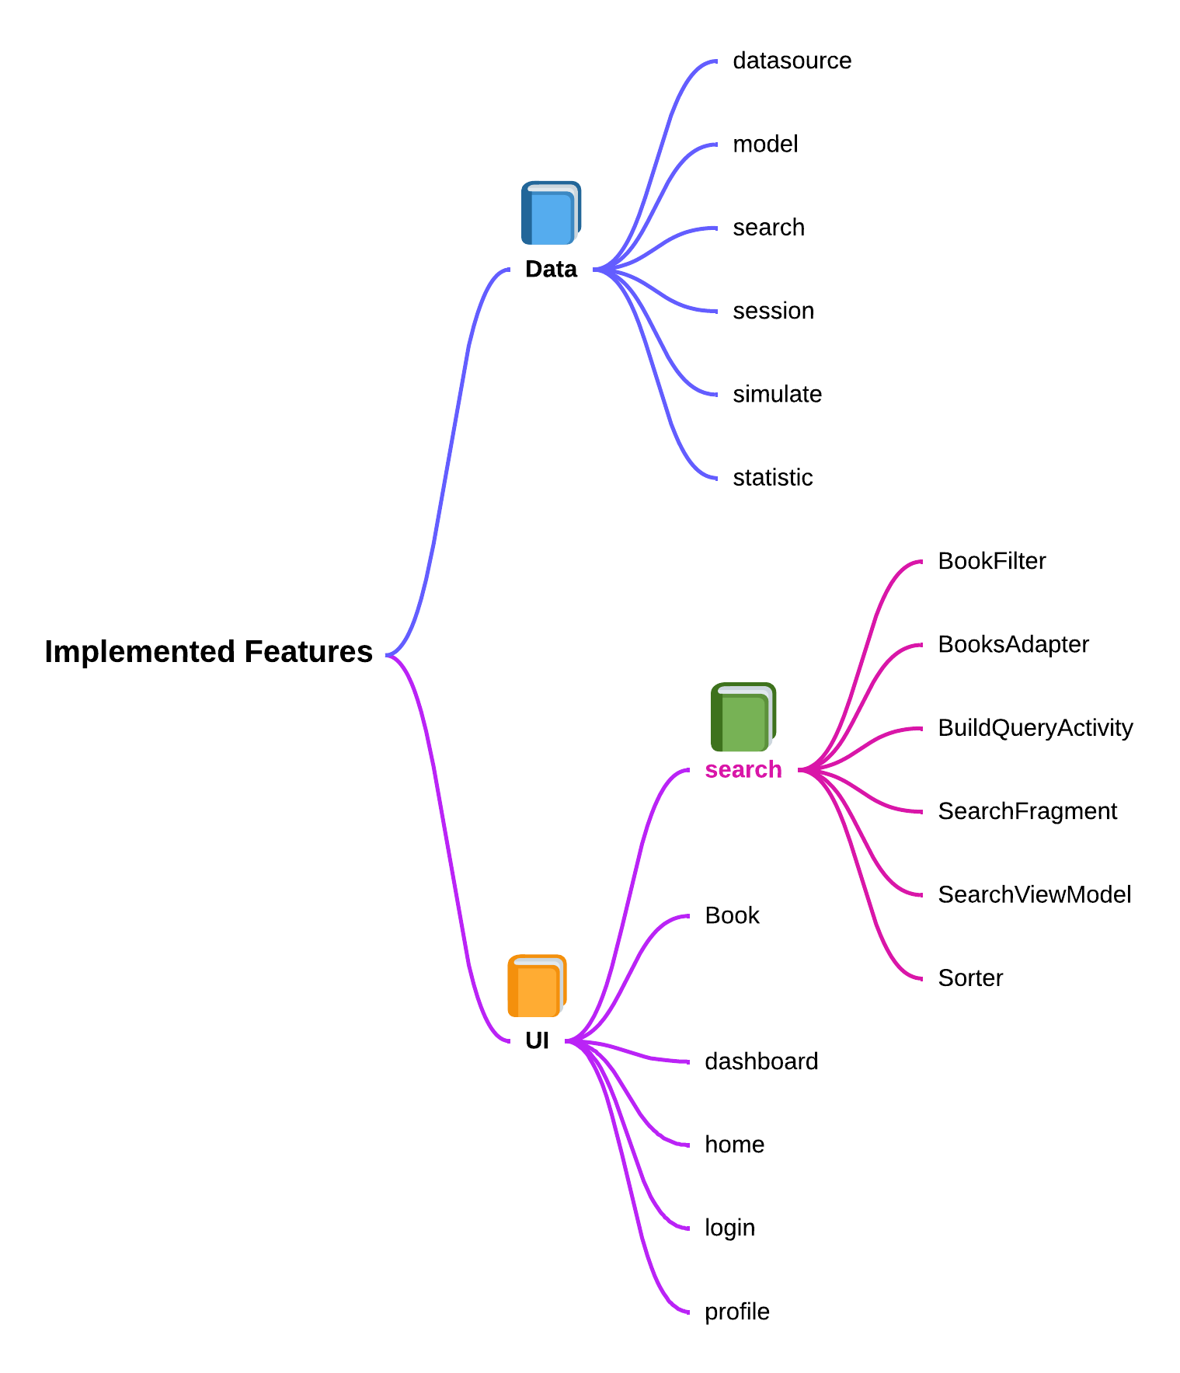


Design and Conclusion
Design
Conclusion
Q&A
3/3

